Slide 1

DriverPass
System Analysis
Jaden Mericle
Notes:
Hello, and thank you for joining me. My name is Jaden Mericle, and today I’ll be walking you through the system design for DriverPass. This system will help streamline how students register, schedule lessons, and prepare for driving exams online.

Slide 2

System Requirements
Functional Requirements:
Students must be able to register for driving courses and schedule lessons.
Instructors must be able to manage their schedules and update lesson availability.
Nonfunctional Requirements:
The system should be accessible online at all times (high availability).
User data must be stored securely and follow privacy best practices.
Notes:
This slide outlines what our system must do and how it should perform. Functionally, students and instructors need to interact with scheduling features. Nonfunctionally, the system must always be available online, and all user data must be kept secure, supporting privacy standards. These directly align with the concerns raised during the DriverPass interview.

Slide 3
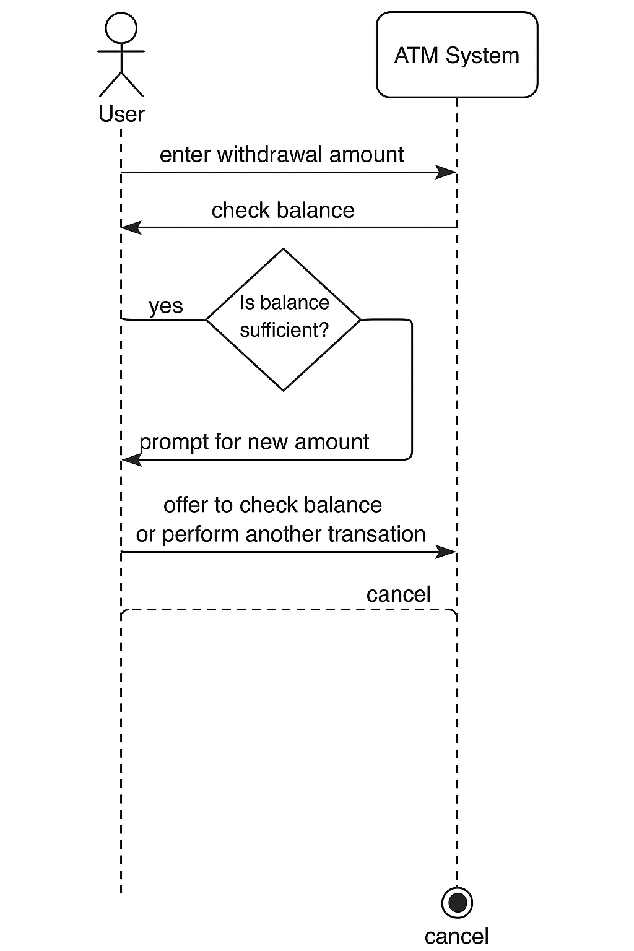
Use Case Diagram
Notes:
This diagram shows the different users—students, instructors, and administrators—and the main actions they take in the system. For example, students can register, schedule lessons, and make payments, while instructors manage their schedules. This helps us understand how users will interact with the system at a high level.

Slide 4
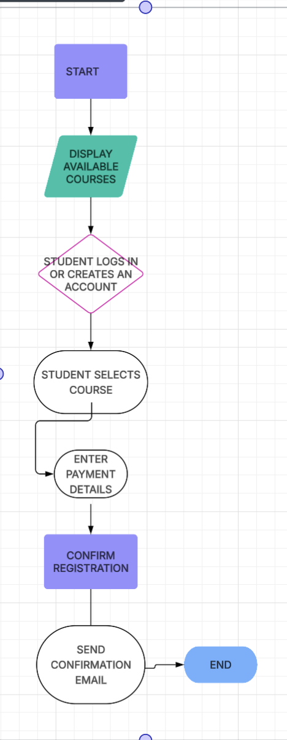
Activity
Diagram
Notes:
[Explain your diagram. Which use case are you breaking down? What are the steps for this use case? How did you account for DriverPass’s needs in your design? In your explanation, keep your audience in mind. Avoid the use of technical terms such as “nodes,” “control flows,” and so on.]

Slide 5
Security
Security Measures:
Encrypted storage of passwords and personal data.
Role-based access to restrict data visibility.
Secure payment processing via a trusted third-party gateway.
Regular system updates and vulnerability scans.
Notes:
Security is a top priority for DriverPass. All sensitive information, like passwords and addresses, will be encrypted. Different users will only see the information they need—students won’t see instructor data and vice versa. Payments will be handled through a secure third-party processor, and we’ll regularly update the system to stay protected from threats.

Slide 6
System Limitations
Limitations:
The system does not currently support offline access.
Limited support for multiple languages at launch.
Instructor availability is dependent on manual input.
No mobile app version in the initial release.
Notes:
While the system covers all essential functions, there are a few limitations to note. Right now, the platform requires an internet connection and is only available in English. Instructors also have to update their schedules manually, and there is no mobile app just yet—though these features may be added in future updates.

